Slide 1
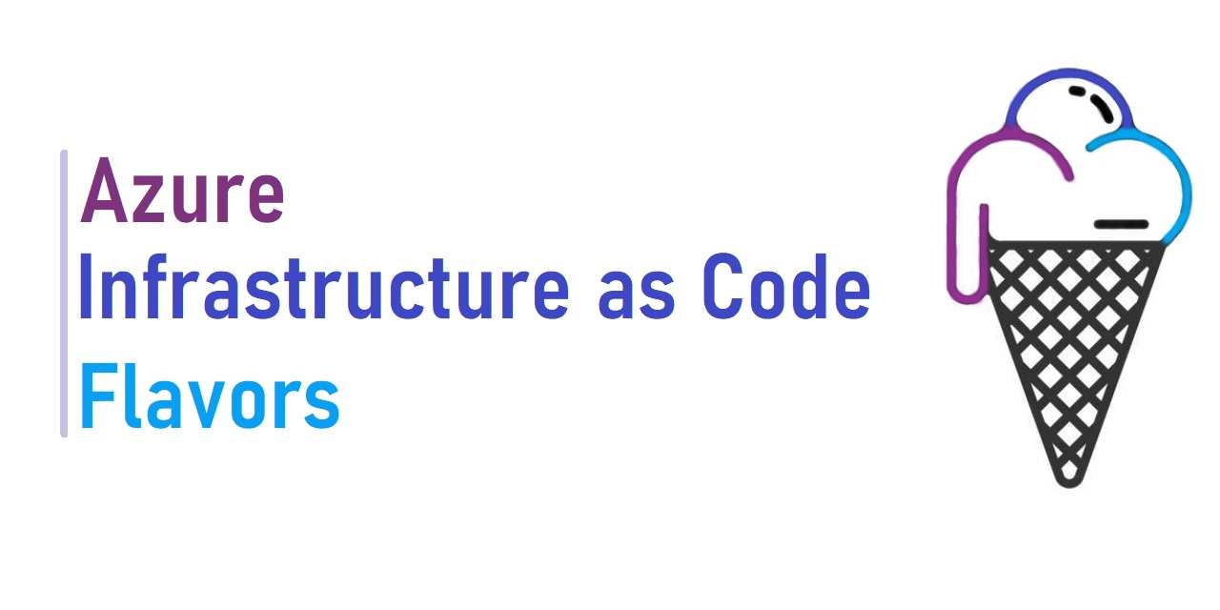
John Folberth
Senior Cloud Solutions Architect – Engineering
Microsoft
Health and Life Sciences

Slide 2






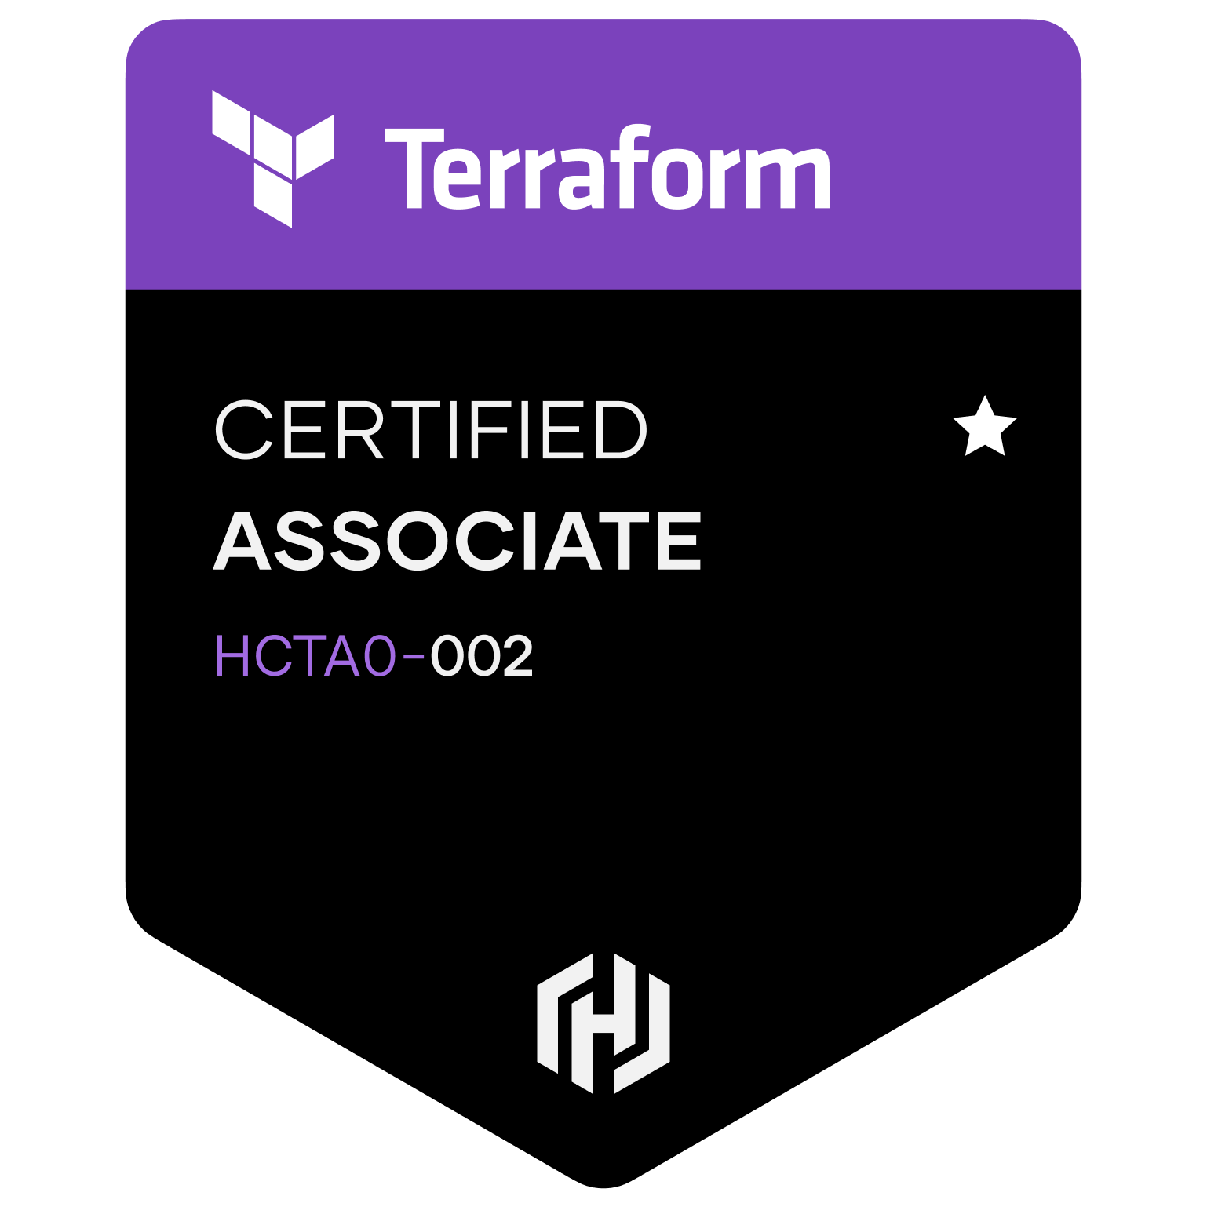

John Folberth
Based out of Grand Rapids, MI
Former Azure MVP
Microsoft Certified Trainer (MCT)
DevOps Advocate
Peer reviewer on “Building Application with Azure Resource Manager: Leverage IaC to Vastly Improve the Life Cycle of your Applications”
Spoken at various User Groups and Conferences on topics ranging from Infrastructure as Code, DevOps YAML Pipelines, and modern Data Analytics Platforms
Experience as Lead DevOps engineer on multiple accounts

Slide 3
Agenda
Introduction
What is Infrastructure As Code (IaC)?
Benefits
Best Practices
Flavors of IaC
ARM
Bicep
Terraform
Pulumi

Slide 4

Everyone Has a Favorite Ice Cream….
What about allegories?
Regional Flavors?

Slide 5


Key Terminology
State File
Parameters/variables
Day 1 Support
Provider
Modules
Registries

Slide 6

But First….Let’s Review Benefits IaC
Reduce Risk of Human Error
Quickly create additional environments and/or instances
Placing infrastructure resources under CI/CD and source control for better quality and collaboration
Reusable modules to drive consistency and lower bearer of entry
Enhanced Security
Simultaneously deploy to multiple cloud environments

Slide 7

Best Practices
IaC code is stored together with application code
Faster Development Time
Adhere to same Software Delivery Lifecycle
Deployed together to prevent drift/staleness
Code is redeployable
Easily readable
Independent Reusable Modules
All Key values are parameters/variables
Insert into any project
No secrets stored in the codebase
Each environment specifics is a separate parameter file
Ideally eliminates all manual intervention

Slide 8
Agenda
Introduction
What is Infrastructure As Code (IaC)?
Benefits
Best Practices
Flavors of IaC
ARM
Bicep
Terraform
Pulumi

Slide 9

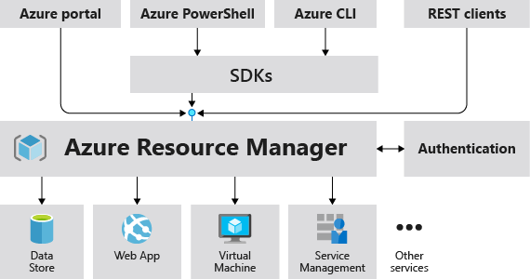
Azure Resource Manager Template (ARM)
JSON File Format
Explicitly track dependencies
Native export from Azure
Day 1 Support
Azure specific
No state file
Native Tool for Azure Development

Slide 10

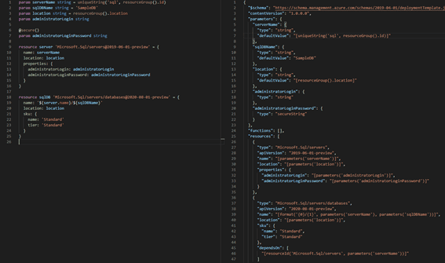
Azure Bicep
Domain Specific Language (DSL)
No State File
Compiles to an ARM template
Bicep is released monthly
Day 1 Support
Azure is only provider available
Registry Support
First Production release v 3.1 in March 2021

Slide 11

Hashicorp Terraform
Requires a state file
Providers are open sourced
Terraform itself is cloud agnostic, providers aren’t
Secrets stored in the state file
Managing/tracking provider and Terraform versions
Multiple cloud and non cloud providers available
Best practice tends to have use lower case and `_` in place of spaces
Support vary by provider/resource type
More detailed information on changes

Slide 12

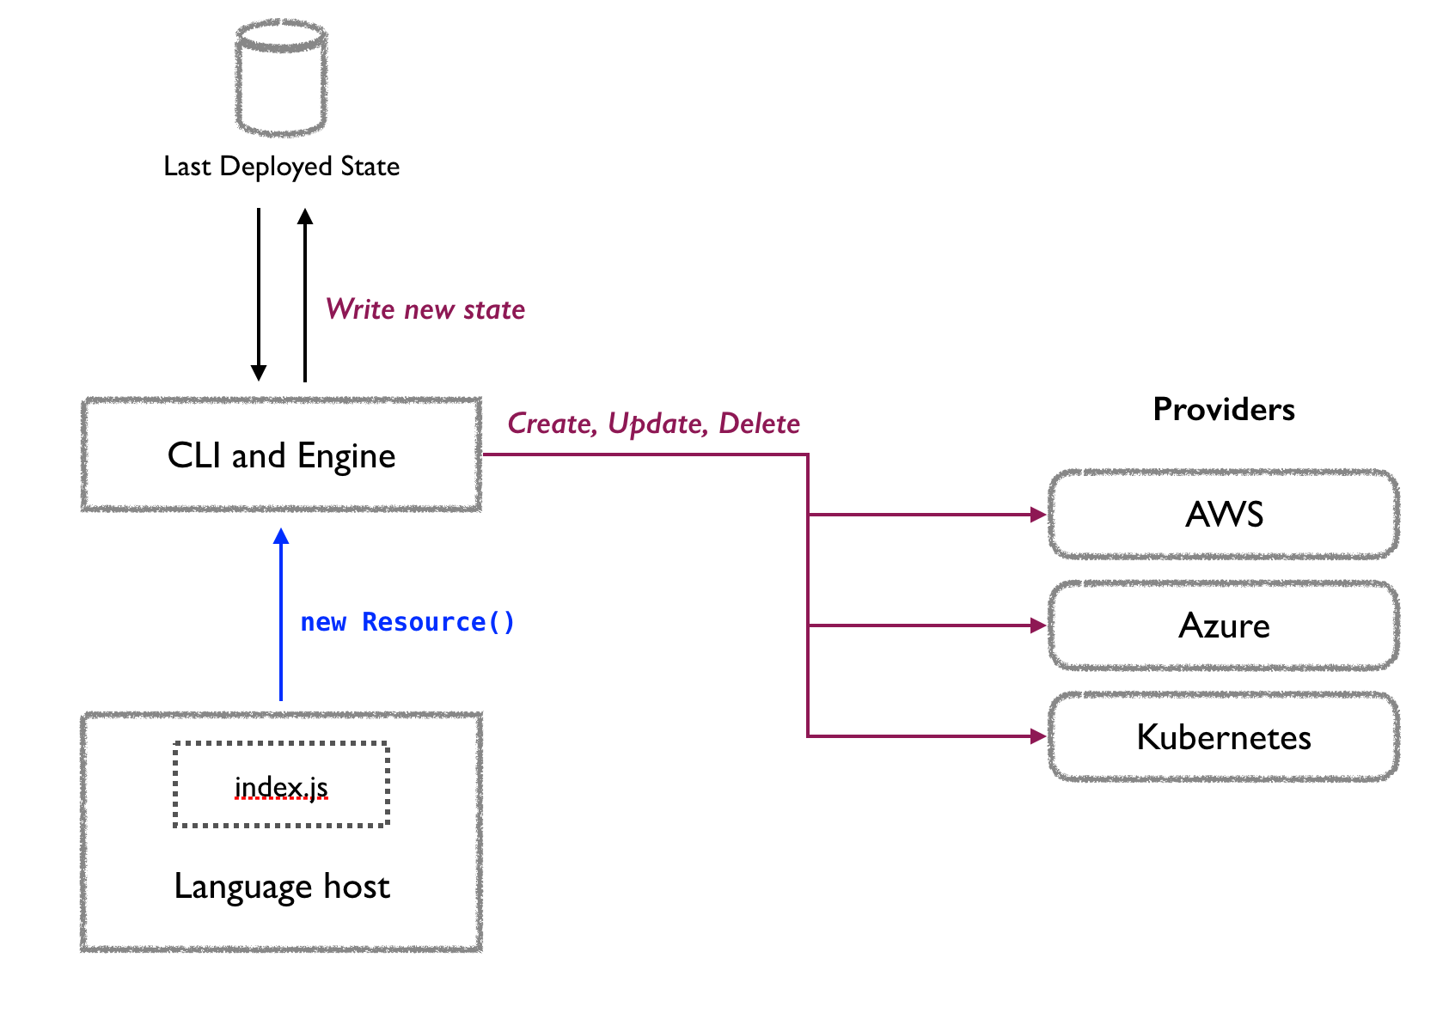
Pulumi
Manage remote resource definition via Pulumi Service
"Modules" are defined and hosted in npm packages
Still considered the "new kid" on the block
Open source
Spaghetti Code Risk
Can use native code formatters
Typescript
YAML
Go
C#
Python
Java

Slide 13
Everyone Has a Favorite Ice Cream….
Questions/Comments/Conundrums

